Slide 1

Analysis of Early Alzheimer’s Diagnosis
2025
Michigan Technological University
Rahul Sajith
Shubham Tiwari

Slide 2
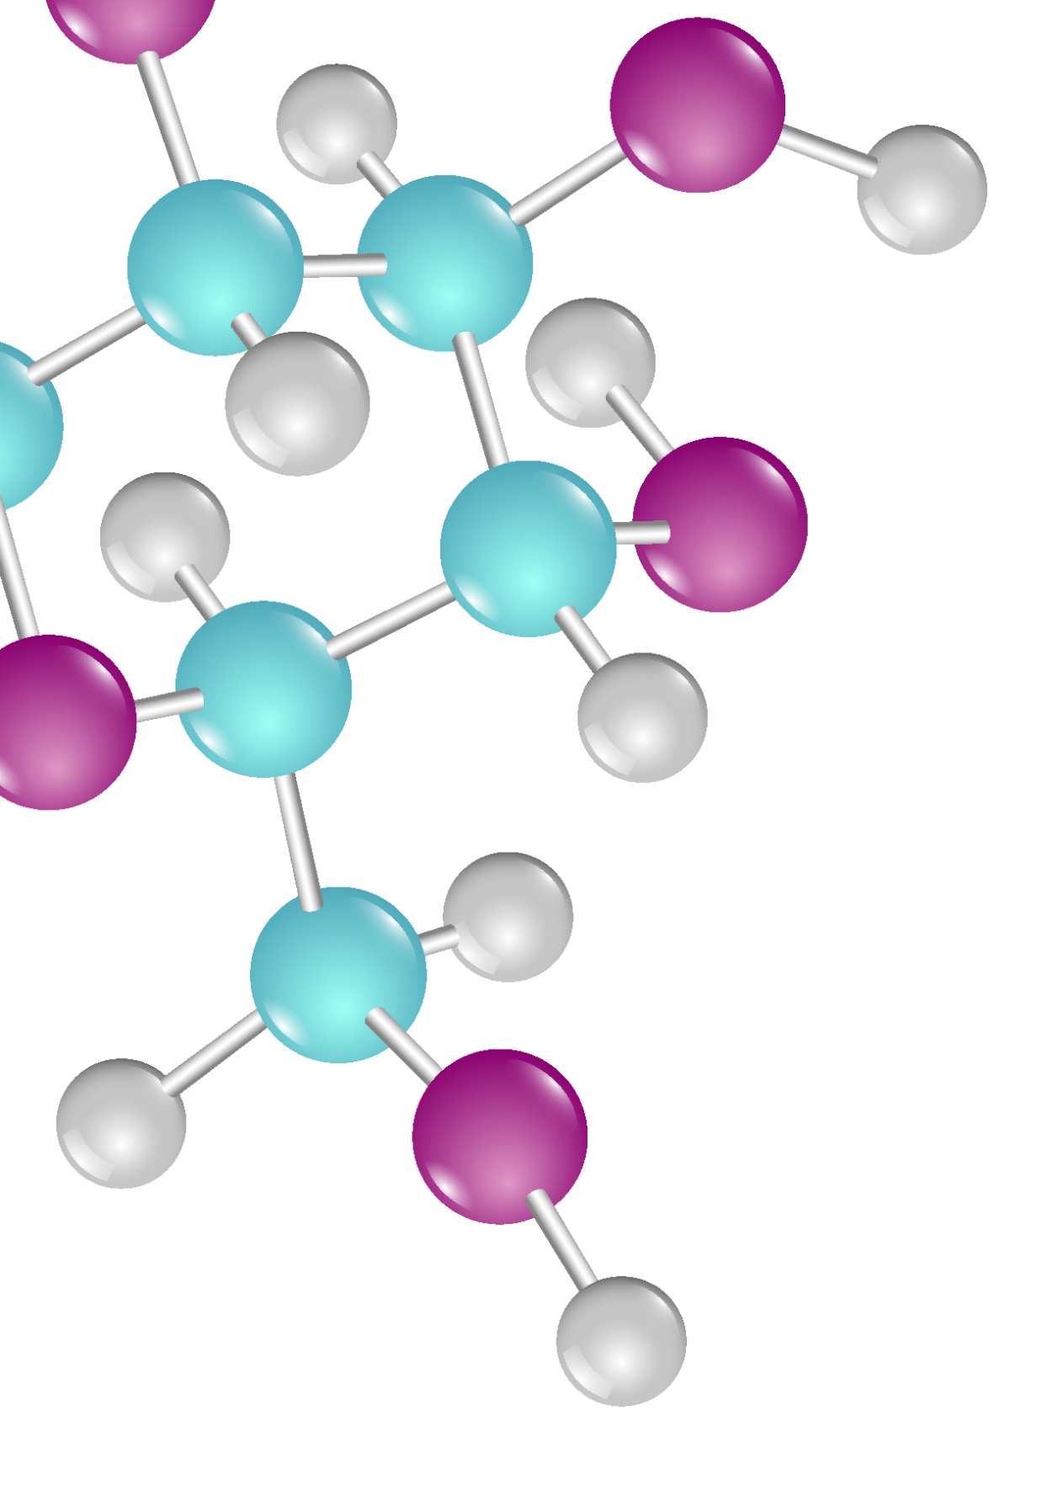
Goal
2025
Comprehensive Analysis of Early Alzheimer’s disease diagnosis using Machine Learning Technique on brain Imaging and demographic data.
Michigan Technological University

Slide 3

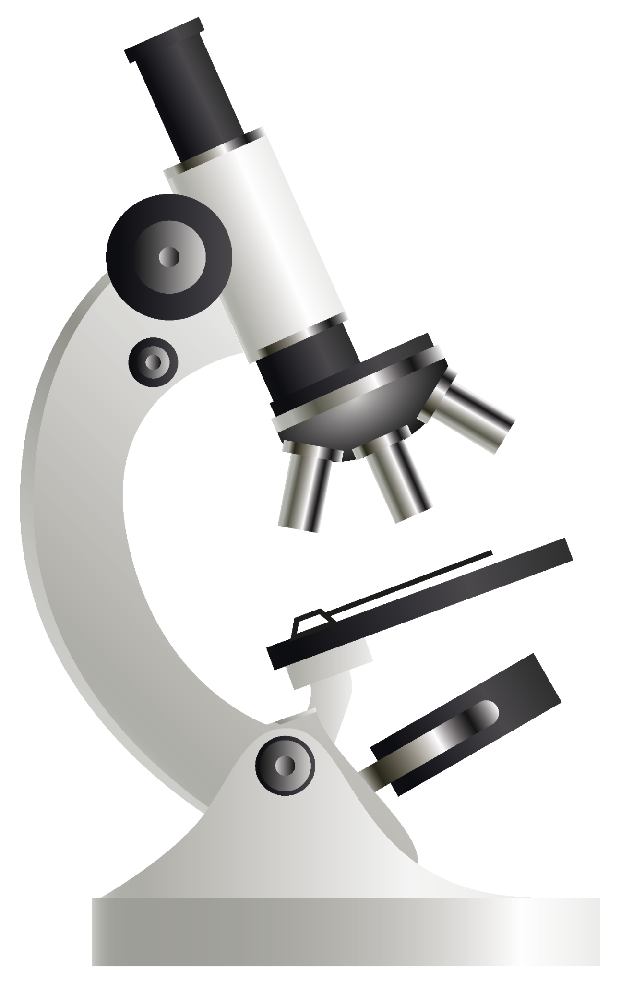
Objective
The Project explores different models and technique to classify patients into three categories :
Cognitively Normal (CN)
Mild Cognitive Impairment (MCI)
Alzheimer’s Disease (AD)

Slide 4
Data Overview
Data Source :
OASIS -1 Free surfer Data
This set consists of a cross-sectional collection of 416 subjects aged 18 to 96. For each subject, 3 or 4 individual T1-weighted MRI scans obtained in single scan sessions are included. The subjects are all right-handed and include both men and women. 100 of the included subjects over the age of 60 have been clinically diagnosed with very mild to moderate Alzheimer’s disease (AD). Additionally, a reliability data set is included containing 20 nondemented subjects imaged on a subsequent visit within 90 days of their initial session.
2025
Michigan Technological University

Slide 5
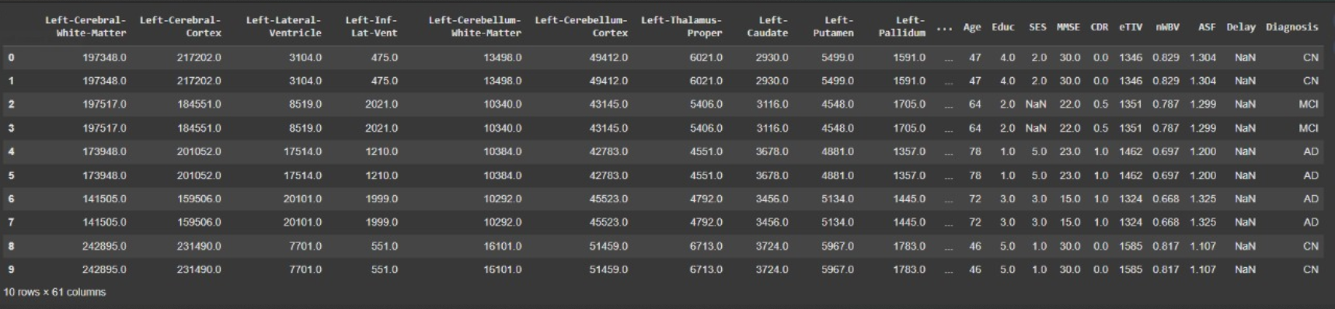
Data

Slide 6
Data Preprocessing
Merged OASIS -1 Free Surfer Data with demographic data using Subject ID
Dropped Unnecessary Column like Subject ID , Diagnosis, CDR, M/F, Hand, Delay
Also dropped any rows with missing values.
Class Balancing: Applied Synthetic Minority Over-sampling Technique (SMOTE) to address class imbalance issues and enhance model reliability.
Encoded Target Labels using labelEncoder.
Data Splitting & Scaling: Divided data into training and testing sets (train-test split).
2025
Michigan Technological University

Slide 7
Model Selection
Models Evaluated :
Random Forest
XGBoost
1D CNN

Slide 8
Random Forest
Mixed Data Handling – Works with numerical (brain volumes, age) and categorical (SES) features.
Class Imbalance Robustness – Mitigates bias in imbalanced data
Feature Importance – Ranks key brain regions for diagnosis (critical for medical insights).
Overfitting Resistance – Bagging reduces overfitting, ideal for smaller medical datasets.

Slide 9
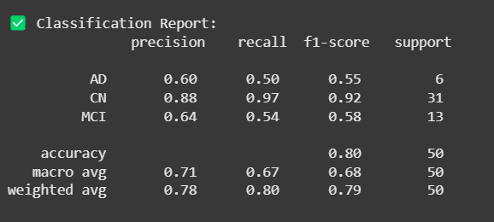
RF

Slide 10
XGBoost
Optimized Performance: Uses gradient boosting to sequentially correct errors, often outperforming Random Forest.
Handles Imbalance Better: metric='mlogloss' to optimize for multi-class imbalance (AD/CN/MCI).
Regularization: Built-in L1/L2 penalties prevent overfitting—critical for high-dimensional neuroimaging data.
Speed: More efficient than Random Forest for large feature sets.

Slide 11
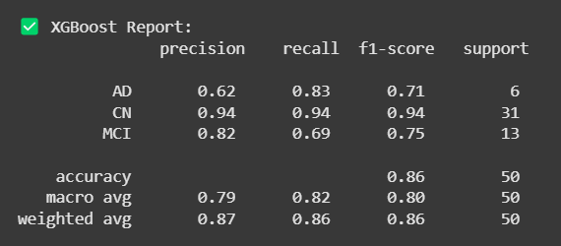
XGBoost

Slide 12
1D CNN
A 1D CNN is well-suited for your Alzheimer's dataset because it captures local patterns in brain region features, unlike Random Forest/XGBoost that treat features independently.
It handles high-dimensional data by automatically learning key combinations without manual engineering

Slide 13
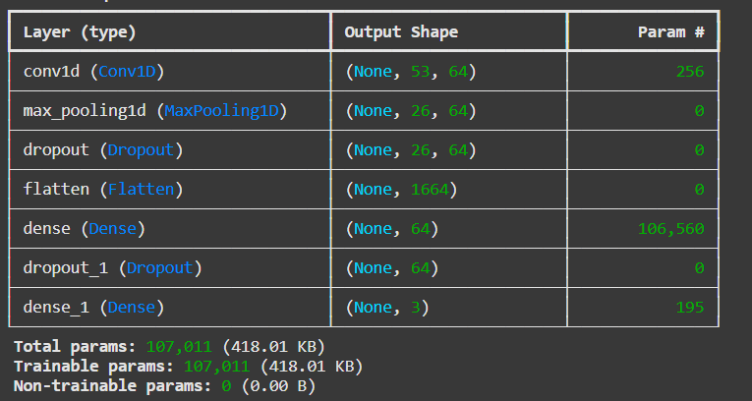
1D CNN

Slide 14
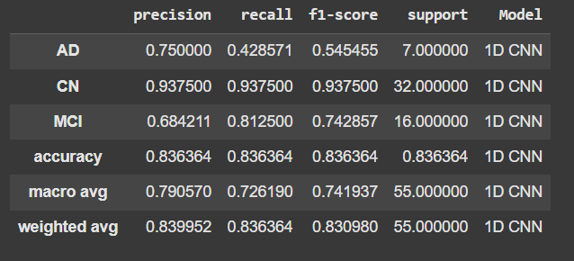
1D CNN

Slide 15
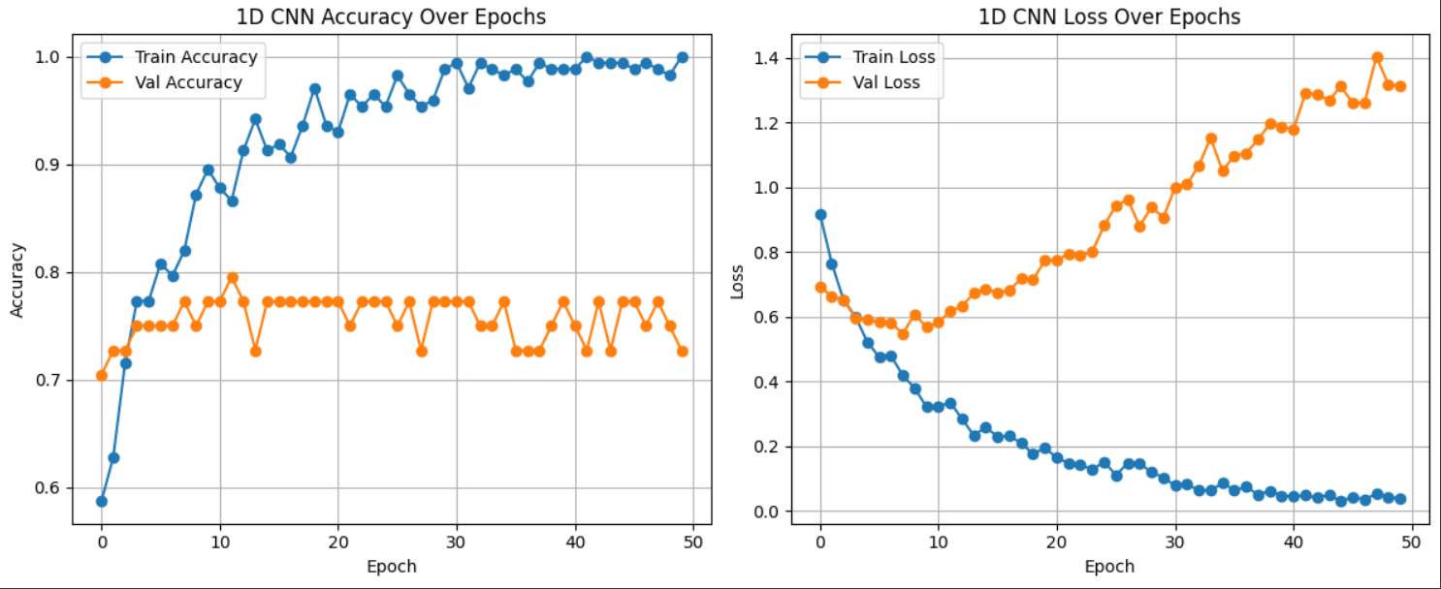
1D CNN

Slide 16
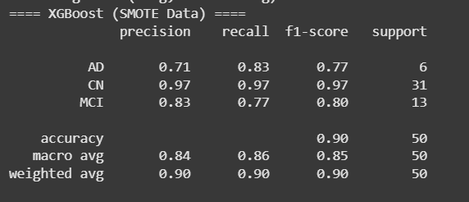
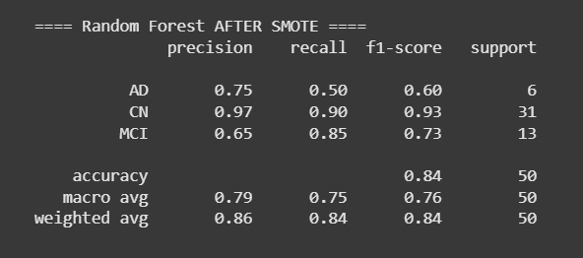
With Balanced dataset (After SMOT)

Slide 17
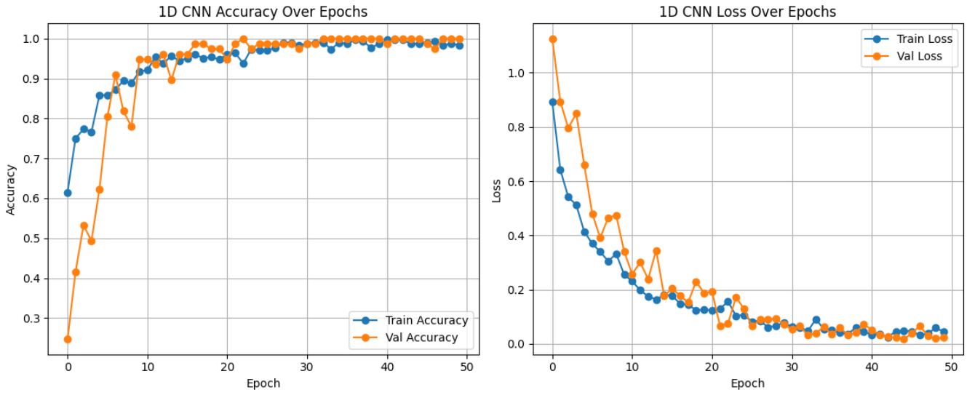
1D CNN (SMOT)

Slide 18
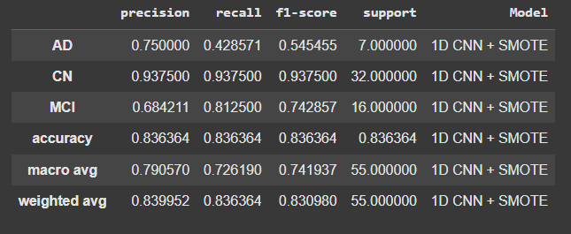
1D CNN (SMOT)

Slide 19
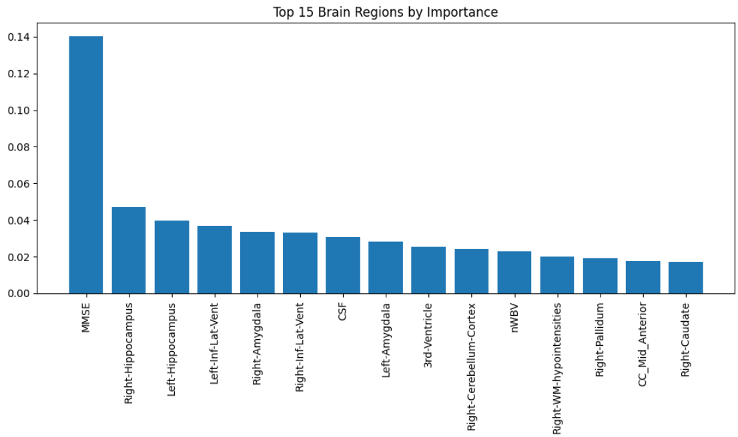
Top Features of Data

Slide 20
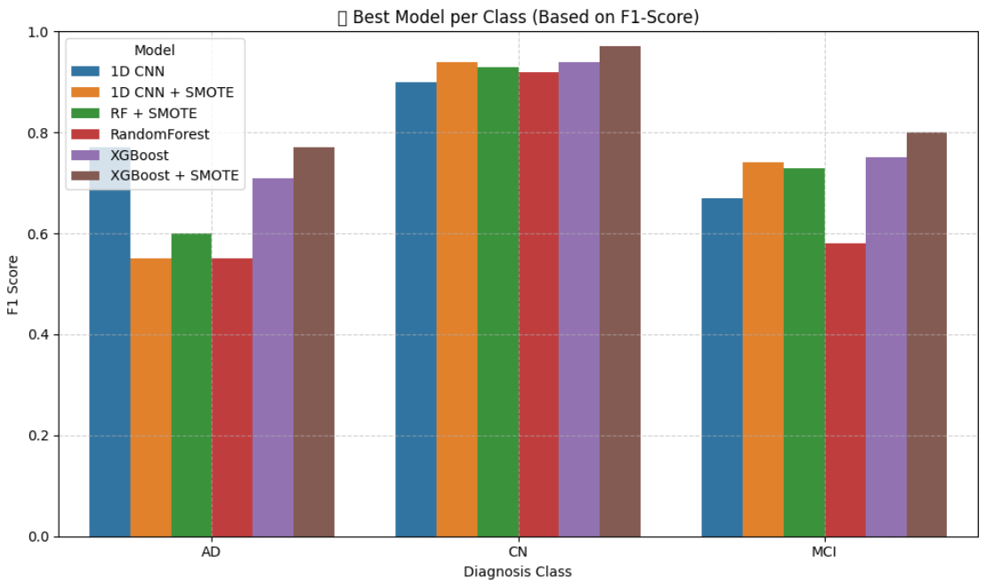
Results

Slide 21
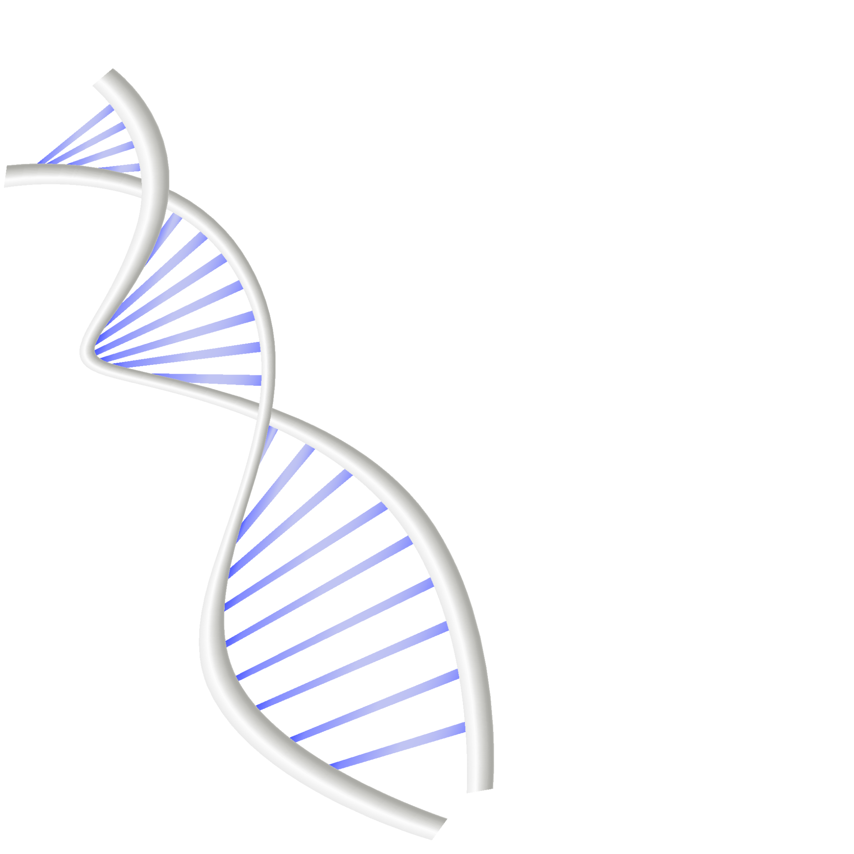
THANKS

